Slide 1
Format String Vulnerabilities
Chester Rebeiro
Indian Institute of Technology Madras
https://chetrebeiro@bitbucket.org/casl/sse.git (directory src/format_string)
https://crypto.stanford.edu/cs155/papers/formatstring-1.2.pdf

Slide 2
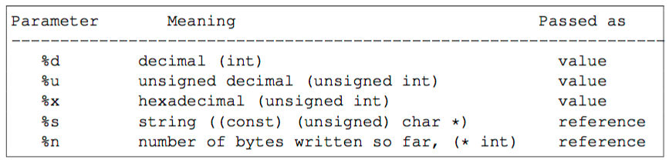
Format Strings
printf ("The magic number is: %d\n", 1911);
format string
arguments
Format specifier
Function declaration of printf
void printf (char **fmt, . . .);
variable arguments

Slide 3
printf invocation
stack
void main(){
printf (“a b c store %d %d %s respectively\n", a, b, c);
}
c
b
a
printf function invocation in main
ptr to fmt string
return Address
prev frame pointer
Locals of function
In printf
a b c store %d %d %s respectively\n

Slide 4
stack
void printf(char *fmt, ...){
va_list ap; /* points to each unnamed arg in turn */
char *p, *sval; /* p points to the format string fmt */
int ival;
double dval;
va_start(ap, fmt); /*make ap point to 1st unnamed arg */
for (p = fmt; *p; p++) {
if (*p != '%’) {
putchar(*p);
continue;
}
switch (*++p) {
case 'd':
ival = va_arg(ap, int);
print_int(ival);
break;
| | | | |
case 's':
for (sval = va_arg(ap, char *); *sval; sval++)
putchar(*sval);
break;
default:
putchar(*p);
break;
}
}
va_end(ap); /* clean up when done */
}
c
b
a
ptr to fmt string
return Address
prev frame pointer
Locals of function
This is c
a b c store %d %d %s respectively\n

Slide 5
stack
void printf(char *fmt, ...){
va_list ap; /* points to each unnamed arg in turn */
char *p, *sval; /* p points to the format string fmt */
int ival;
double dval;
va_start(ap, fmt); /*make ap point to 1st unnamed arg */
for (p = fmt; *p; p++) {
if (*p != '%’) {
putchar(*p);
continue;
}
switch (*++p) {
case 'd':
ival = va_arg(ap, int);
print_int(ival);
break;
| | | | |
case 's':
for (sval = va_arg(ap, char *); *sval; sval++)
putchar(*sval);
break;
default:
putchar(*p);
break;
}
}
va_end(ap); /* clean up when done */
}
c
ap
b
a
ptr to fmt string
return Address
prev frame pointer
Locals of function
This is c
p
a b c store %d %d %s respectively\n

Slide 6
stack
void printf(char *fmt, ...){
va_list ap; /* points to each unnamed arg in turn */
char *p, *sval; /* p points to the format string fmt */
int ival;
double dval;
va_start(ap, fmt); /*make ap point to 1st unnamed arg */
for (p = fmt; *p; p++) {
if (*p != '%’) {
putchar(*p);
continue;
}
switch (*++p) {
case 'd':
ival = va_arg(ap, int);
print_int(ival);
break;
| | | | |
case 's':
for (sval = va_arg(ap, char *); *sval; sval++)
putchar(*sval);
break;
default:
putchar(*p);
break;
}
}
va_end(ap); /* clean up when done */
}
c
ap
b
a
ptr to fmt string
return Address
prev frame pointer
Locals of function
This is c
p
a b c store %d %d %s respectively\n

Slide 7
stack
void printf(char *fmt, ...){
va_list ap; /* points to each unnamed arg in turn */
char *p, *sval; /* p points to the format string fmt */
int ival;
double dval;
va_start(ap, fmt); /*make ap point to 1st unnamed arg */
for (p = fmt; *p; p++) {
if (*p != '%’) {
putchar(*p);
continue;
}
switch (*++p) {
case 'd':
ival = va_arg(ap, int);
print_int(ival);
break;
| | | | |
case 's':
for (sval = va_arg(ap, char *); *sval; sval++)
putchar(*sval);
break;
default:
putchar(*p);
break;
}
}
va_end(ap); /* clean up when done */
}
c
ap
b
a
ptr to fmt string
return Address
prev frame pointer
Locals of function
This is c
p
a b c store %d %d %d respectively\n

Slide 8
stack
void printf(char *fmt, ...){
va_list ap; /* points to each unnamed arg in turn */
char *p, *sval; /* p points to the format string fmt */
int ival;
double dval;
va_start(ap, fmt); /*make ap point to 1st unnamed arg */
for (p = fmt; *p; p++) {
if (*p != '%’) {
putchar(*p);
continue;
}
switch (*++p) {
case 'd':
ival = va_arg(ap, int);
print_int(ival);
break;
| | | | |
case 's':
for (sval = va_arg(ap, char *); *sval; sval++)
putchar(*sval);
break;
default:
putchar(*p);
break;
}
}
va_end(ap); /* clean up when done */
}
ap
c
b
a
ptr to fmt string
return Address
prev frame pointer
Locals of function
This is c
p
a b c store %d %d %s respectively\n

Slide 9
stack
void printf(char *fmt, ...){
va_list ap; /* points to each unnamed arg in turn */
char *p, *sval; /* p points to the format string fmt */
int ival;
double dval;
va_start(ap, fmt); /*make ap point to 1st unnamed arg */
for (p = fmt; *p; p++) {
if (*p != '%’) {
putchar(*p);
continue;
}
switch (*++p) {
case 'd':
ival = va_arg(ap, int);
print_int(ival);
break;
| | | | |
case 's':
for (sval = va_arg(ap, char *); *sval; sval++)
putchar(*sval);
break;
default:
putchar(*p);
break;
}
}
va_end(ap); /* clean up when done */
}
ap
c
b
a
ptr to fmt string
return Address
prev frame pointer
Locals of function
sval
This is c
p
a b c store %d %d %s respectively\n

Slide 10
stack
void printf(char *fmt, ...){
va_list ap; /* points to each unnamed arg in turn */
char *p, *sval; /* p points to the format string fmt */
int ival;
double dval;
va_start(ap, fmt); /*make ap point to 1st unnamed arg */
for (p = fmt; *p; p++) {
if (*p != '%’) {
putchar(*p);
continue;
}
switch (*++p) {
case 'd':
ival = va_arg(ap, int);
print_int(ival);
break;
| | | | |
case 's':
for (sval = va_arg(ap, char *); *sval; sval++)
putchar(*sval);
break;
default:
putchar(*p);
break;
}
}
va_end(ap); /* clean up when done */
}
ap
c
b
a
ptr to fmt string
return Address
prev frame pointer
Locals of function
p
a b c store %d %d %s respectively\n

Slide 11
Insufficient Arguments to printf
void main(){
printf (“%d %d %d\n", a, b);
}
stack
3 format specifiers
But only 2 arguments
b
a
ptr to fmt string
Can the compiler detect this inconsistency?
Generally does not
Would need internal details of printf, making the compiler library dependent.
Format string may be created at runtime
return Address
prev frame pointer
Locals of function
Can the printf function detect this inconsistency?
Not easy
Just picks out arguments from the stack, whenever it sees a format specifier

Slide 12
Exploiting inconsistent printf
Crashing a program
printf ("%s%s%s%s%s%s%s%s%s%s%s%s");
arbitrary
arbitrary
arbitrary
ptr to fmt string
return Address
prev frame pointer
Locals of function
%s%s%s%s%s%s%s%s%s%s%s%s

Slide 13
Exploiting inconsistent printf
Printing contents of the stack
printf ("%x %x %x %x");
0x44444444
0x33333333
0x22222222
0x11111111
11111111 22222222 33333333 44444444
ptr to fmt string
return Address
prev frame pointer
Locals of function
%x %x %x %x

Slide 14
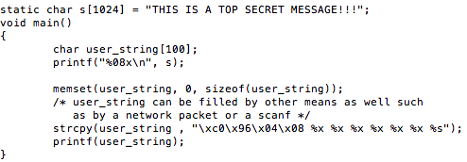
Exploiting inconsistent printf
Printing any memory location
user_string has to be local
This should have the contents of s

Slide 15

Exploiting inconsistent printf
Printing any memory location
user_string has to be local
%s, picks pointer from the stack
and prints from the
pointer till \0
This should have the contents of s
contents of the stack printed by the 6 %x
string pointed to by 0x080496c0. this happens to be ‘s’

Slide 16
Exploiting inconsistent printf
Printing any memory location
user_string has to be local
0x080496c0
This should have the contents of s
THIS IS A TOP SECRET MESSAGE
contents of the stack printed by the 6 %x
string pointed to by 0x080496c0. this happens to be ‘s’

Slide 17
Exploiting inconsistent printf
stack
Printing any memory location
%s
user_string
%x
%x
%x
%x
%x
user_string has to be local
%x
0x080496c0
0xb7fe1b48
0
b776a54
0xbffe72d8
0x0000001a
esp
0x8048566
This should have the contents of s
%s, picks pointer from the stack
and prints from the
pointer till \0
0x080496c0
THIS IS A TOP SECRET MESSAGE

Slide 18
Digging deeper
0x080496c0
THIS IS A TOP SECRET MESSAGE
stack
printf(user_string);
%s
printf will start to read user_string
Whenever it finds a format specifier (%x here)
It reads the argument from the stack
and increments the va_arg pointer
If we have sufficient %x’s, the va_arg pointer will eventually reach user_string[0], which is filled with the desired target address.
At this point we have a %s in user string, thus printf would print from the target address till \0
%x
%x
%x
%x
p
%x
%x
0x08096c0
0xb7fe1b48
0
b776a54
ap
0xbffe72d8
0x0000001a
0x8048566

Slide 19
Digging deeper
0x080496c0
THIS IS A TOP SECRET MESSAGE
stack
printf(user_string);
%s
printf will start to read user_string
Whenever it finds a format specifier (%x here)
It reads the argument from the stack
and increments the va_arg pointer
If we have sufficient %x’s, the va_arg pointer will eventually reach user_string[0], which is filled with the desired target address.
At this point we have a %s in user string, thus printf would print from the target address till \0
%x
%x
%x
p
%x
%x
%x
0x08096c0
0xb7fe1b48
0
b776a54
ap
0xbffe72d8
0x0000001a
0x8048566

Slide 20
Digging deeper
0x080496c0
THIS IS A TOP SECRET MESSAGE
stack
printf(user_string);
%s
printf will start to read user_string
Whenever it finds a format specifier (%x here)
It reads the argument from the stack
and increments the va_arg pointer
If we have sufficient %x’s, the va_arg pointer will eventually reach user_string[0], which is filled with the desired target address.
At this point we have a %s in user string, thus printf would print from the target address till \0
%x
%x
p
%x
%x
%x
%x
0x08096c0
0xb7fe1b48
0
ap
b776a54
0xbffe72d8
0x0000001a
0x8048566

Slide 21
Digging deeper
0x080496c0
THIS IS A TOP SECRET MESSAGE
stack
printf(user_string);
%s
printf will start to read user_string
Whenever it finds a format specifier (%x here)
It reads the argument from the stack
and increments the va_arg pointer
If we have sufficient %x’s, the va_arg pointer will eventually reach user_string[0], which is filled with the desired target address.
At this point we have a %s in user string, thus printf would print from the target address till \0
%x
p
%x
%x
%x
%x
%x
0x08096c0
0xb7fe1b48
ap
0
b776a54
0xbffe72d8
0x0000001a
0x8048566

Slide 22
Digging deeper
0x080496c0
THIS IS A TOP SECRET MESSAGE
stack
printf(user_string);
p
%s
printf will start to read user_string
Whenever it finds a format specifier (%x here)
It reads the argument from the stack
and increments the va_arg pointer
If we have sufficient %x’s, the va_arg pointer will eventually reach user_string[0], which is filled with the desired target address.
At this point we have a %s in user string, thus printf would print from the target address till \0
%x
%x
%x
%x
%x
ap
%x
0x08096c0
0xb7fe1b48
0
b776a54
0xbffe72d8
0x0000001a
0x8048566

Slide 23
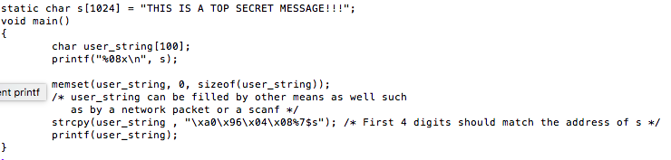
More Format Specifiers
Reduce the number of %x with %N$s
stack
user_string
%7$s
+7
0x08096c0
0xb7fe1b48
0
b776a54
0xbffe72d8
0x0000001a
esp
0x8048566
Pick the 7th argument from the stack.

Slide 24
Overwrite an arbitrary location
%n format specifier : returns the number of characters printed so far.
‘i’ is filled with 5 here
Using the same approach to read data from any location, printf can be used to modify a location as well
Can be used to change function pointers as well as return addresses
int i;
printf(“12345%n”, &i);

Slide 25
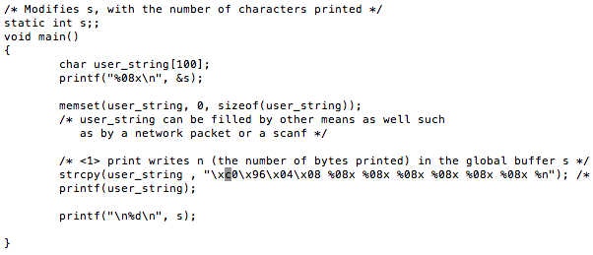
Overwrite Arbitrary Location with some number

Slide 26
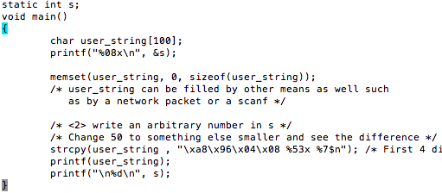
Overwrite Arbitrary Location with Arbitrary Number
An arbitrary number

Slide 27
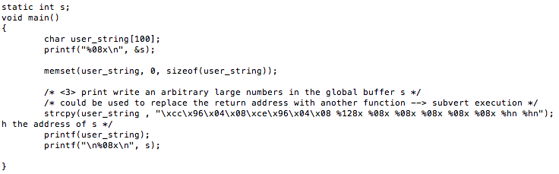
Another useful format specifier
%hn : will use only 16 bits .. Can be used to store large numbers
address of s to store the lower 16bits
address of s to store the higher 16bits
Store the number of characters printed.
Both 16 bit lower and 16 bit higher will be stored separately

